Slide 1
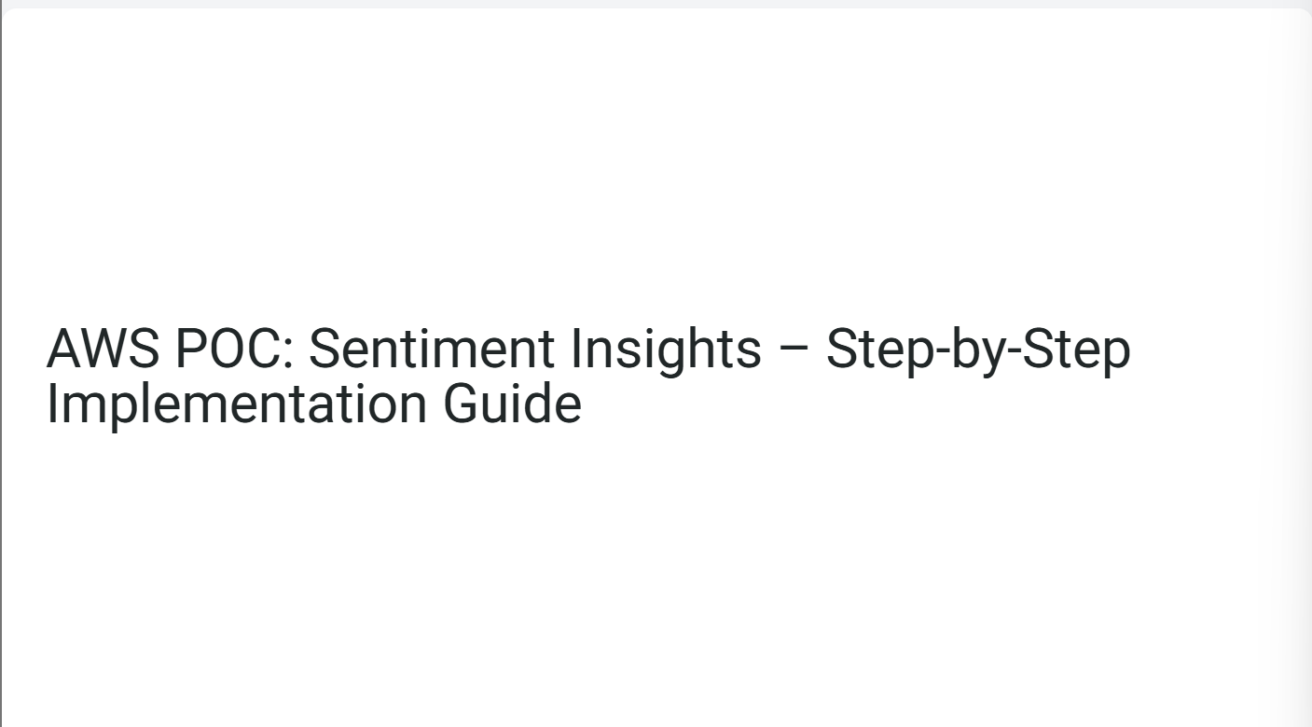
cbdsh

Slide 2
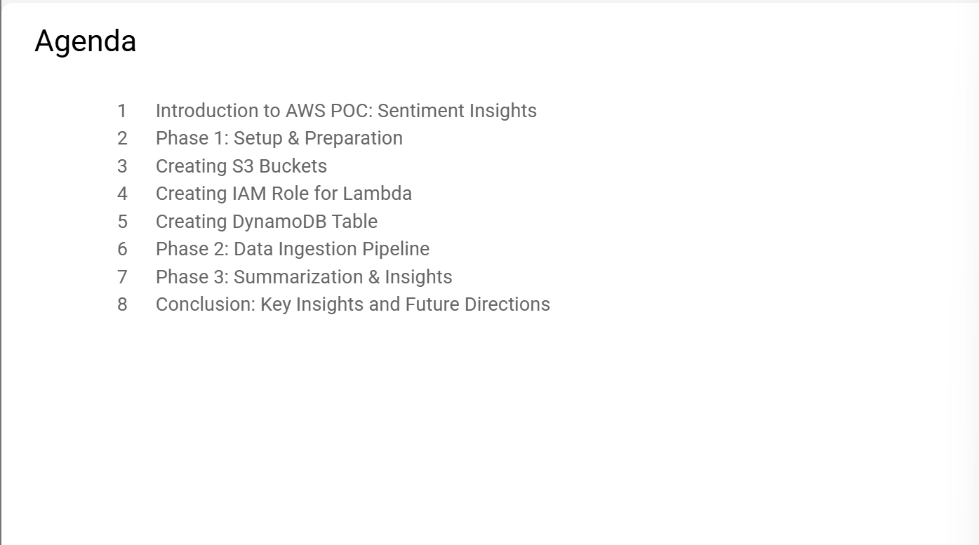

Slide 3
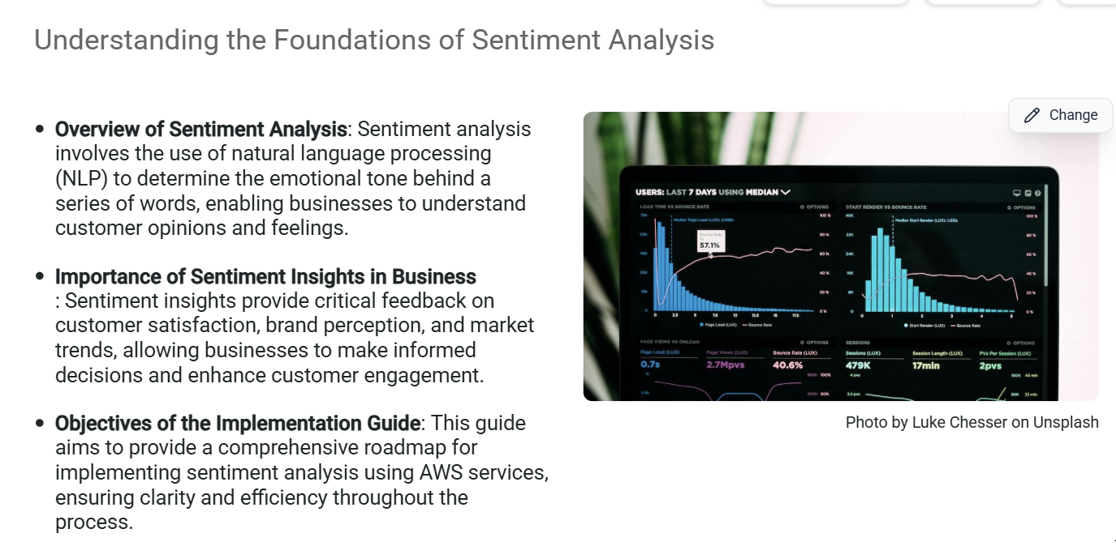

Slide 4
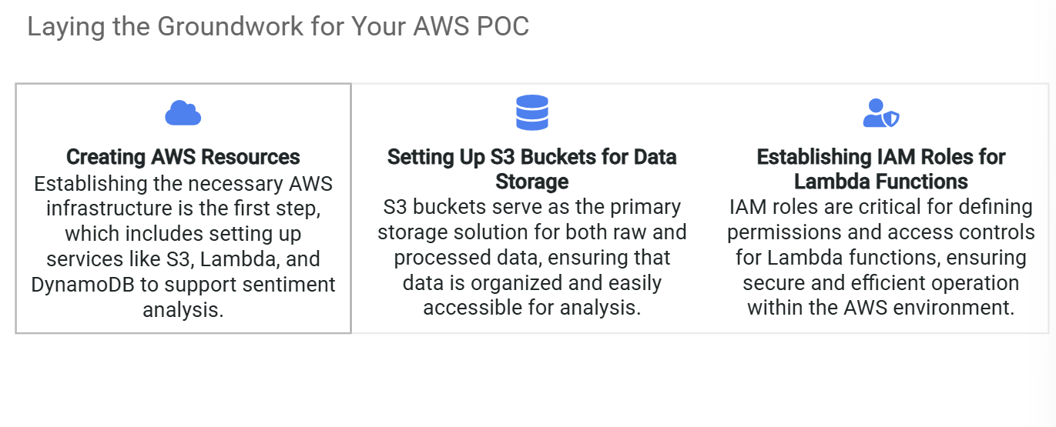
Phase 1: Setup & Preparation

Slide 5
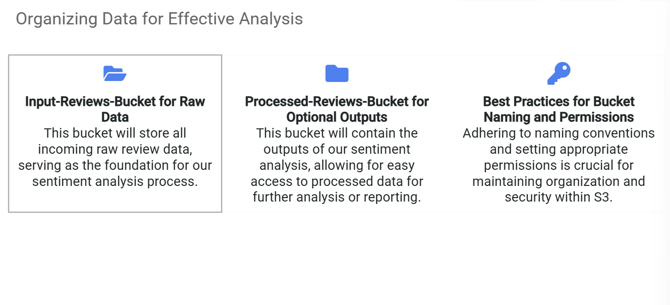
Creating S3 Buckets

Slide 6
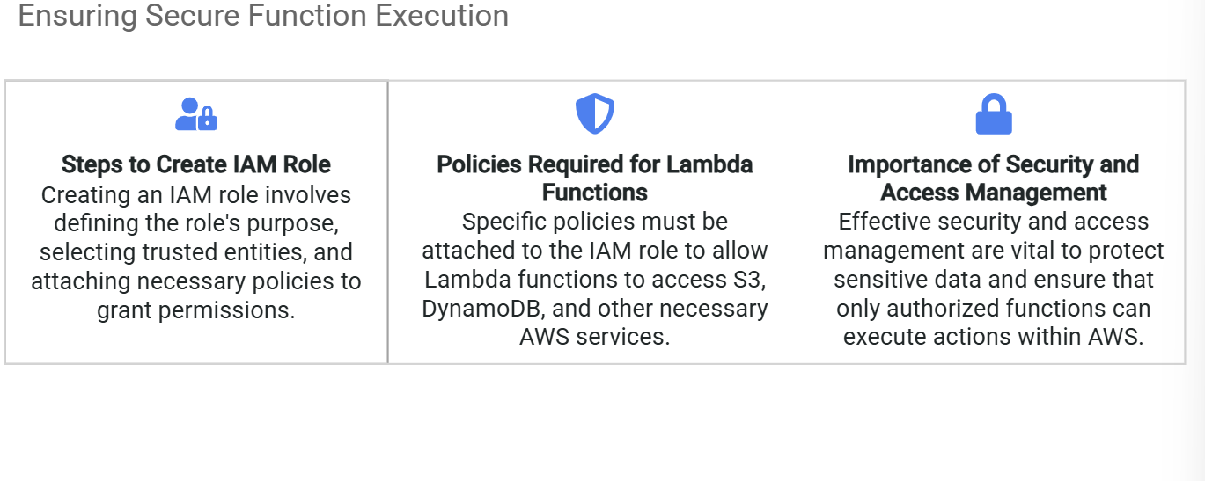
Creating IAM Role for Lambda

Slide 7
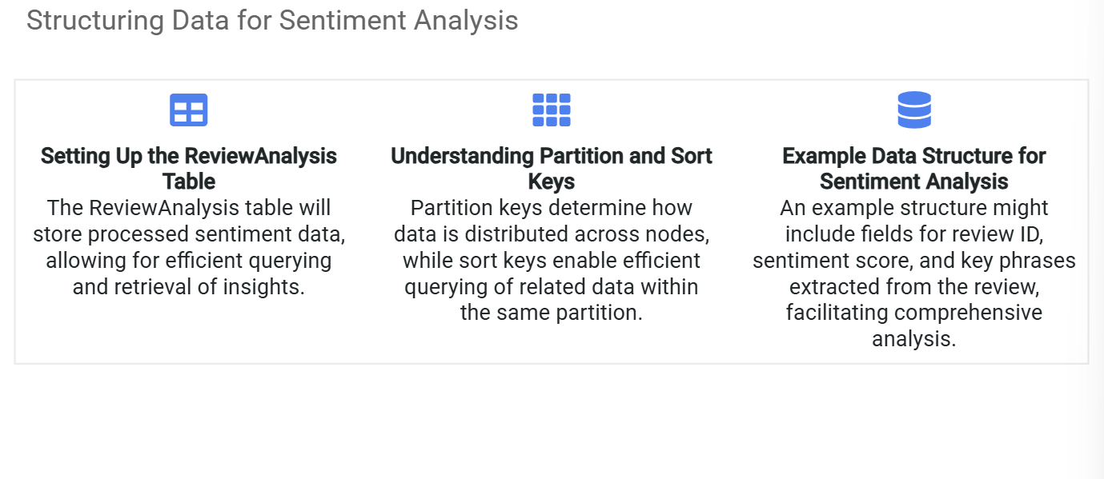
Creating DynamoDB Table

Slide 8
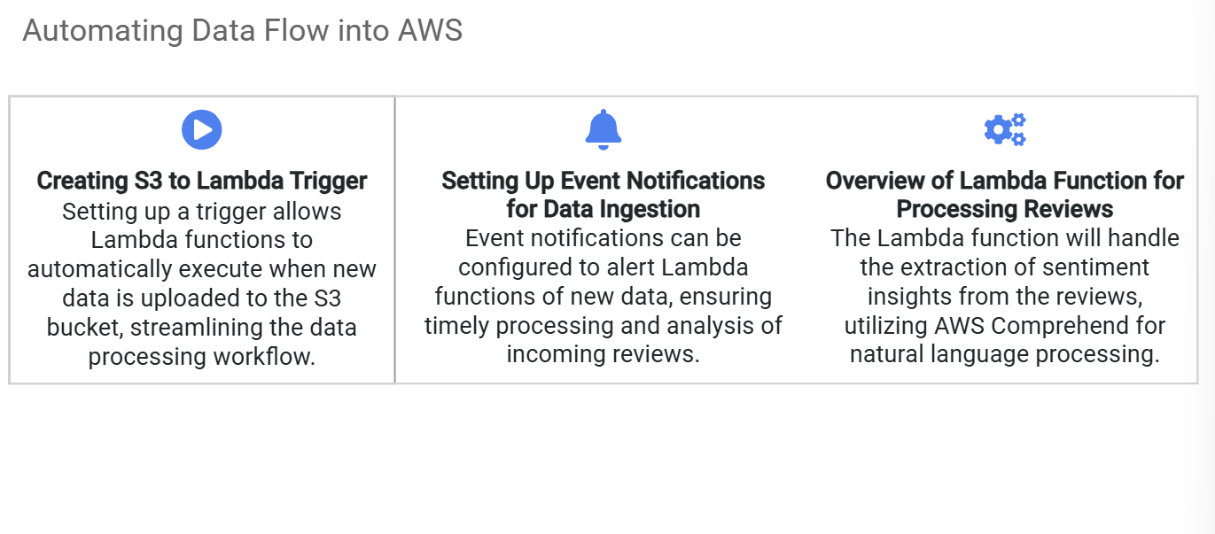
Phase 2: Data Ingestion Pipeline

Slide 9
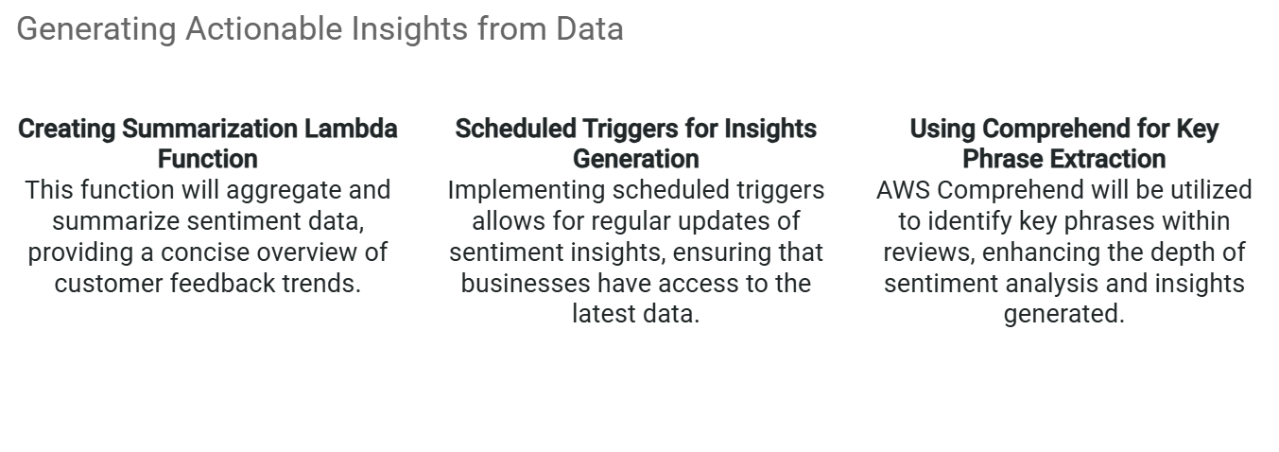
Phase 3: Summarization & Insights

Slide 10
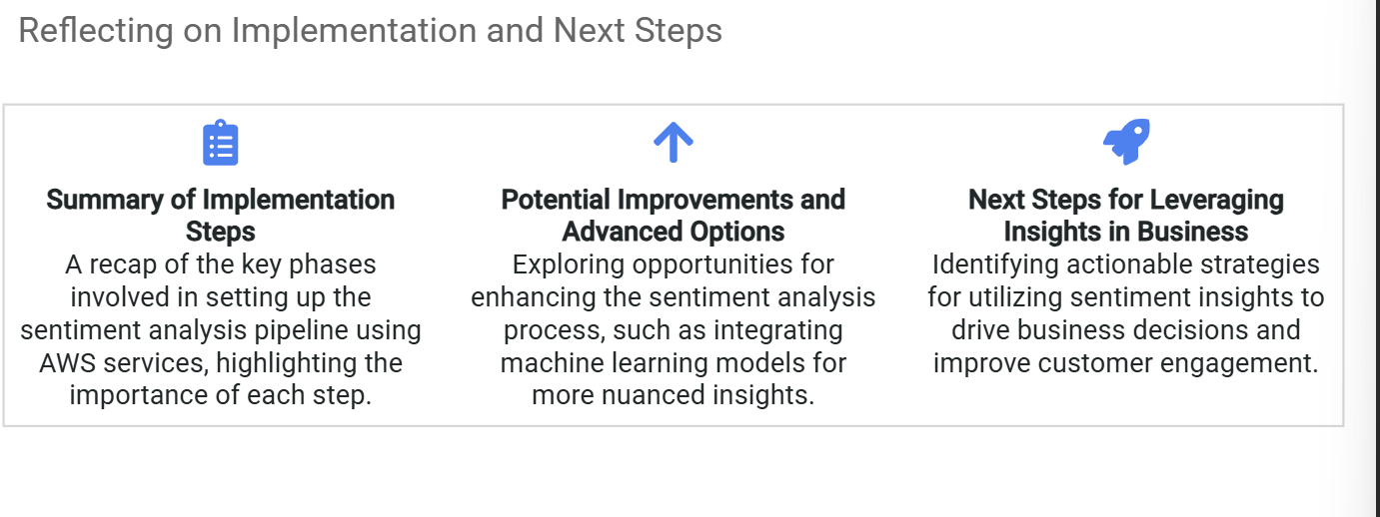
Conclusion: Key Insights and Future Directions

